Slide 1
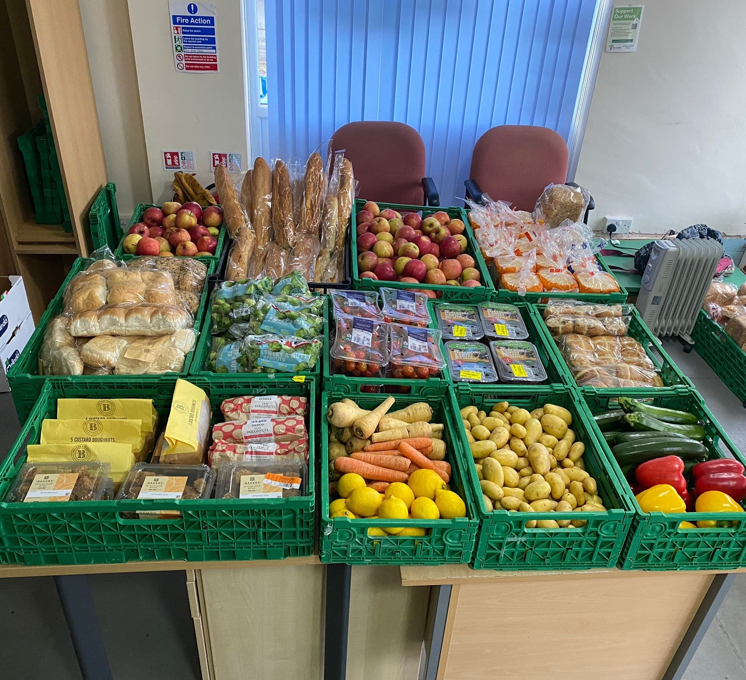

Fighting Food Waste and Feeding the Community
Fighting Food Waste and Feeding the Community

Slide 2
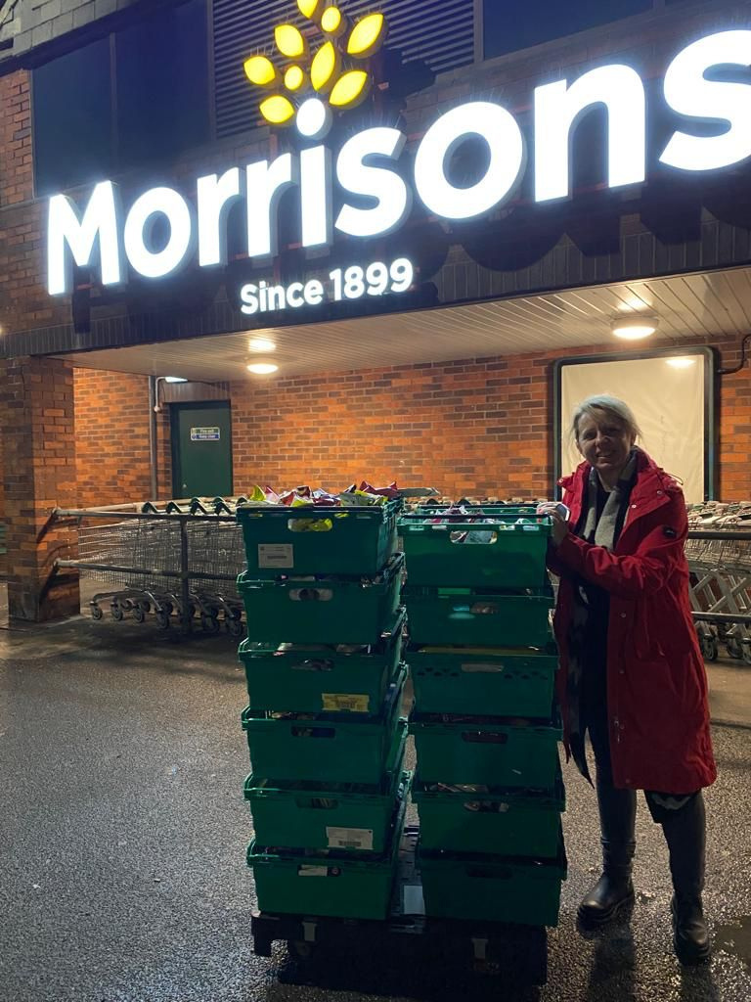
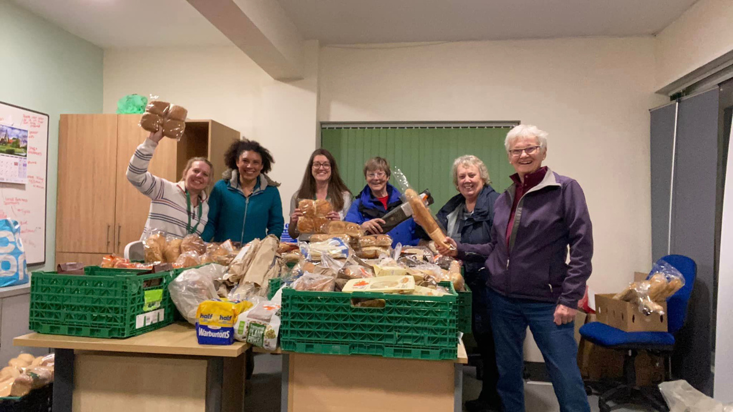
  Up to 3 tonnes of food waste saved every week
  Estimated £1 million worth of food saved to date
  Estimated 1 million kg of Co2 prevented from being created
ABOUT THE PROJECT
40 amazing volunteers
18 local shops

Slide 3


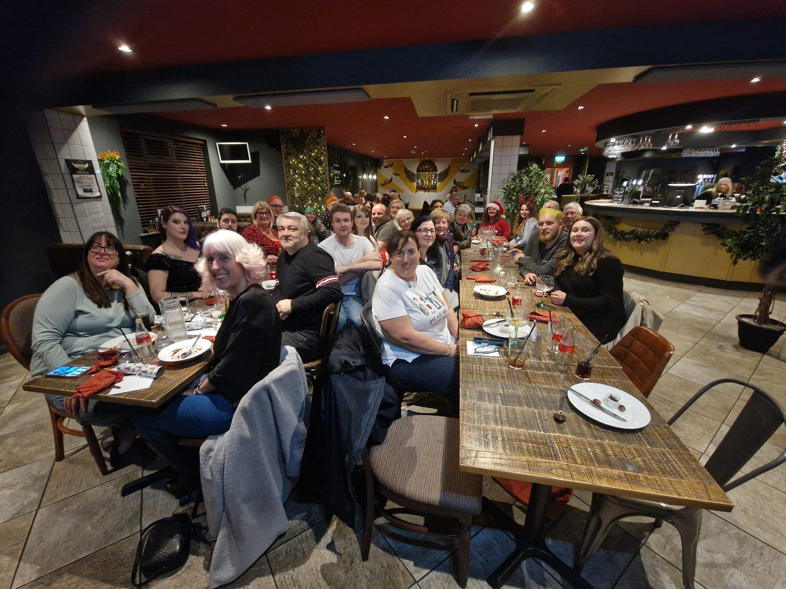
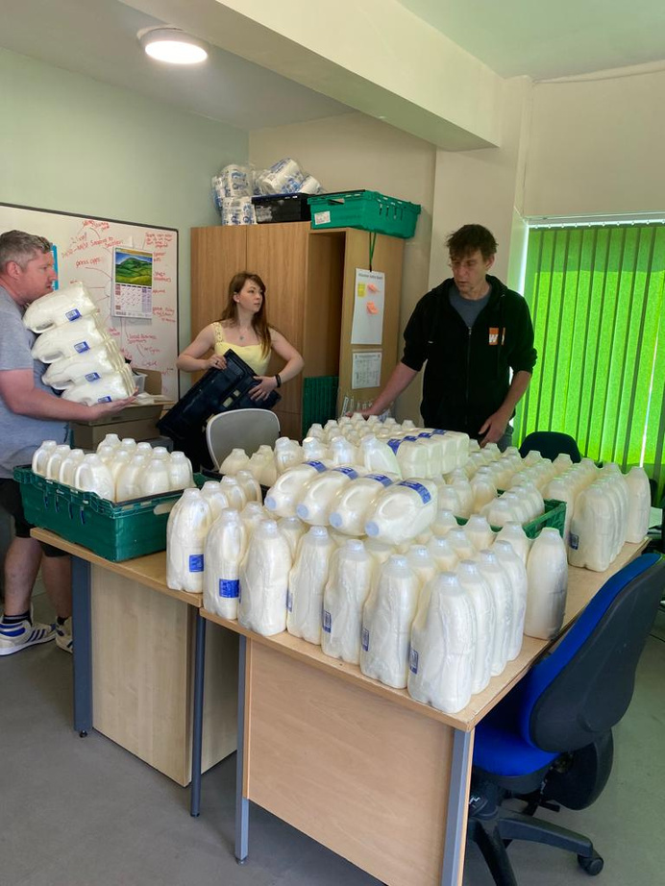
Our Brilliant Volunteers
Our Brilliant Volunteers

Slide 4

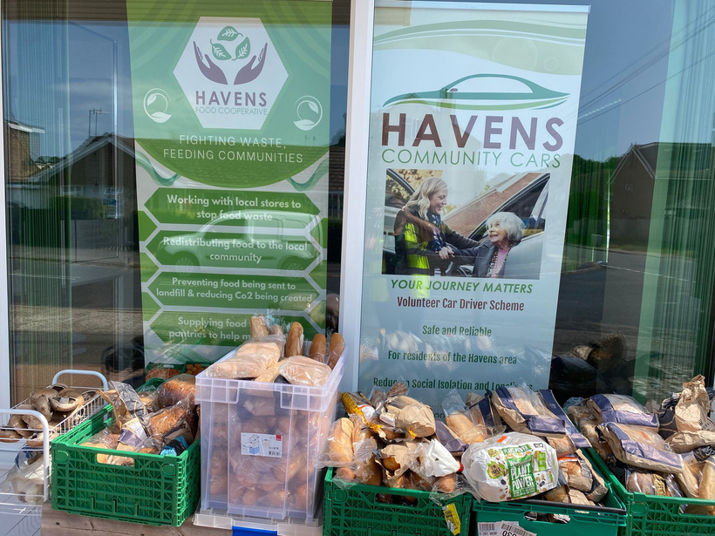
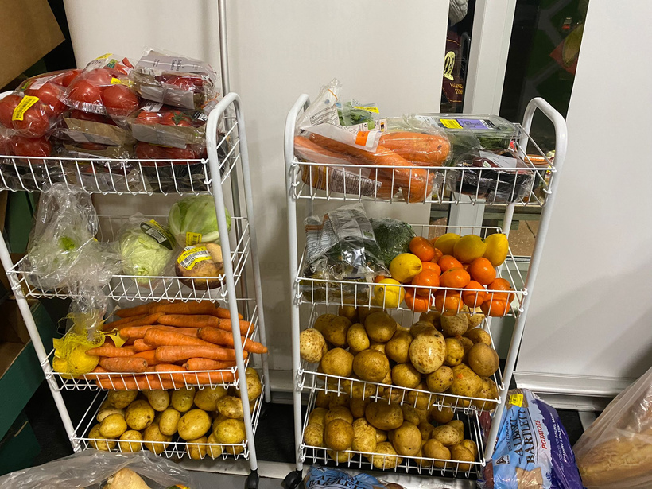
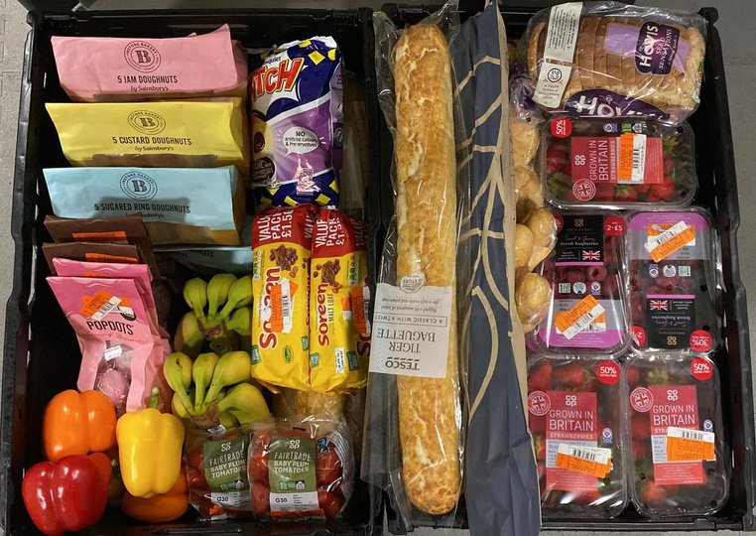
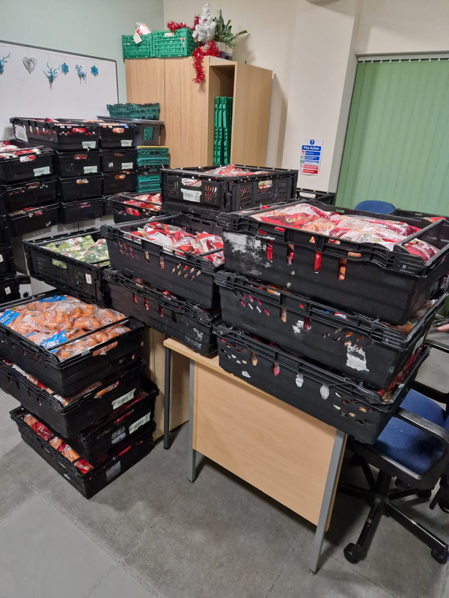
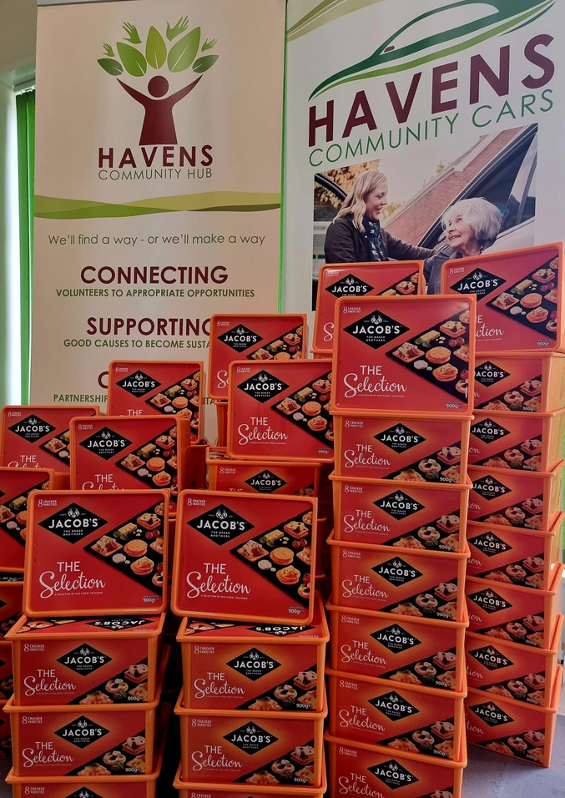
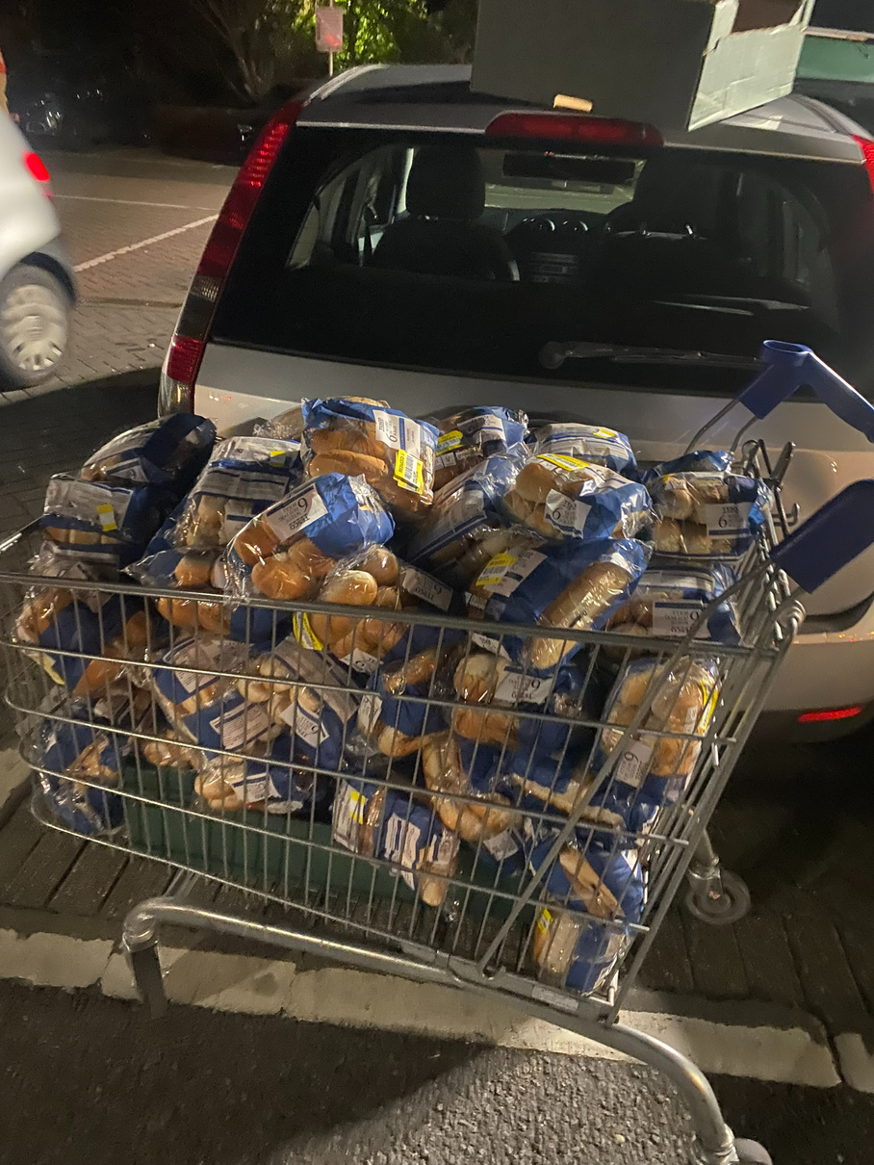
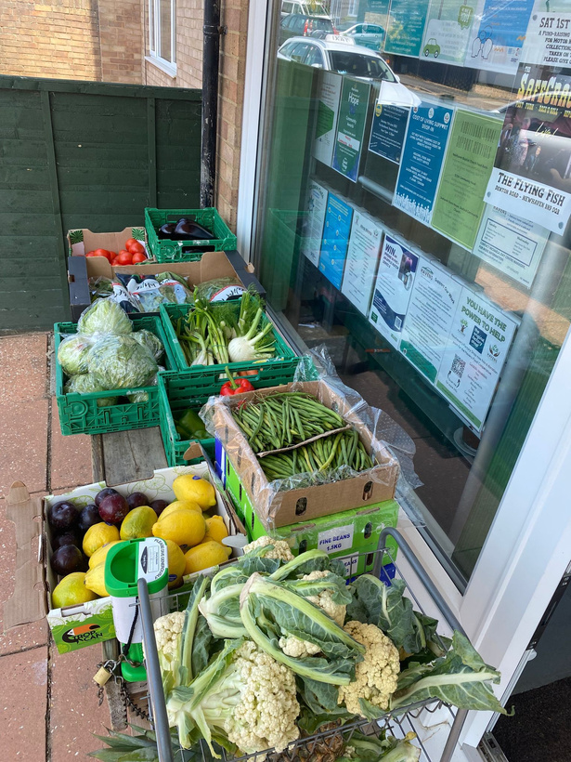
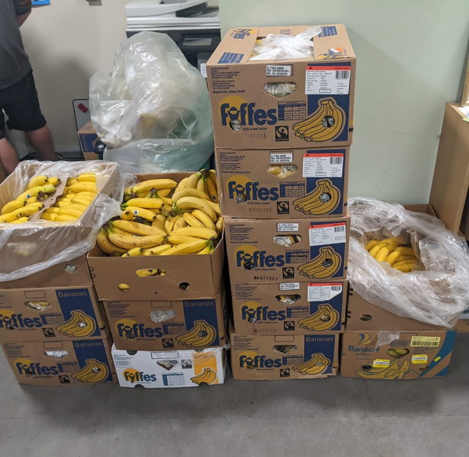
Surplus Food Collections
Surplus Food Collections

Slide 5
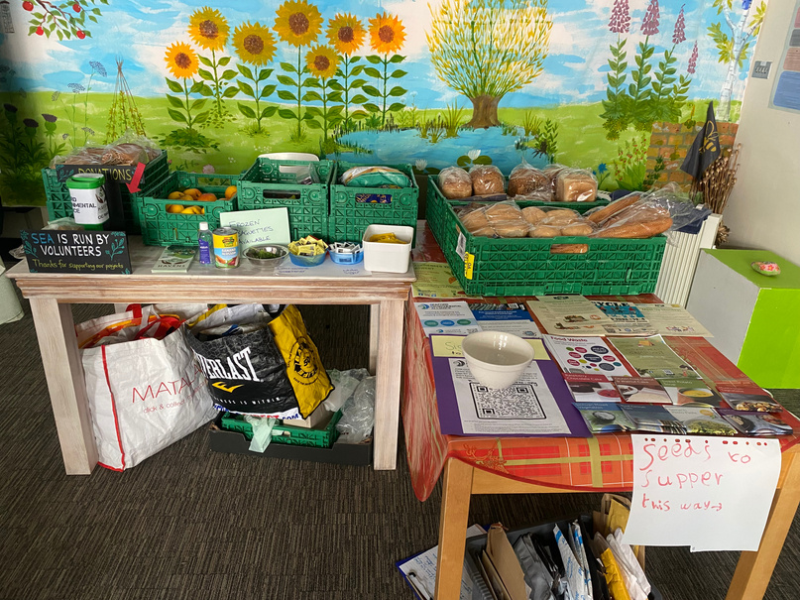
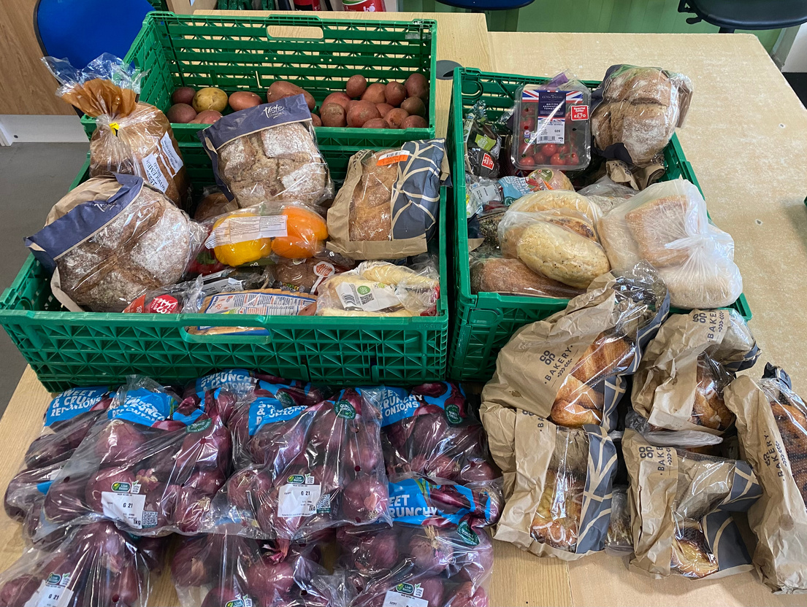

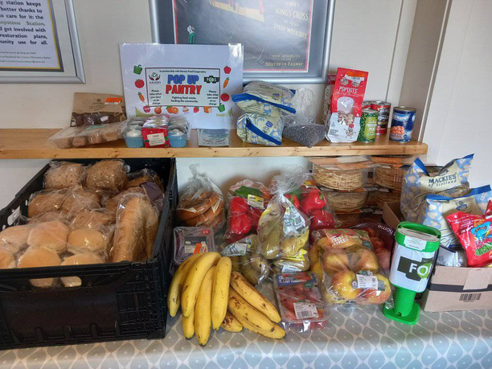
SEAFORD ENVIRONMENTAL ALLIANCE
POP-UP-PANTRY SCHEME
SEAFORD PRIMARY SCHOOL
SEAHAVEN STOREHOUSE
FRIENDS OF BISHOPSTONE STATION

