Slide 1
FRIENDS OF BISHOPSTONE STATION CIC
SEAFORD COUNCIL LARGE GRANT AWARD 2023

Slide 2
ABOUT FOBS
FOBS IS RUN PURELY BY UNPAID VOLUNTEERS
MEET UP MONDAYS HAS BEEN SO SUCCESFUL IN OVERCOMING SOCIAL ISOLATION AND COST OF LIVING CRISIS CREATING A WARM SAFE SPACE.
REGULAR HIRE OF THE FACILITY GOES SOME WAY TO COVER OUR COSTS.
OPEN DAY SATURDAY MAY 4TH 10-1
OFFERING THE COMMUNITY EVENTS THROUGHOUT THE YEAR.
A NEW TWICE MONTHLY FRIDAY MAN SPACE IS PROVING SUCCESFUL.

Slide 3
THE PURPOSE AND EFFECT OF THE SEAFORD COUNCIL GRANT AWARDED TO FOBS
WE REQUESTED A GRANT TO PURCHASE FURTHER IT EQUIPMENT
UP TO DATE EQUIPMENT HAS BEEN ESSENTIAL TO ACCOUNT FOR EVERYTHING WE DO
ENABLED TREASURER TO HAVE ACCOUNTS FACILITY AND SHARE WITH THE COMMITTEE.

Slide 4
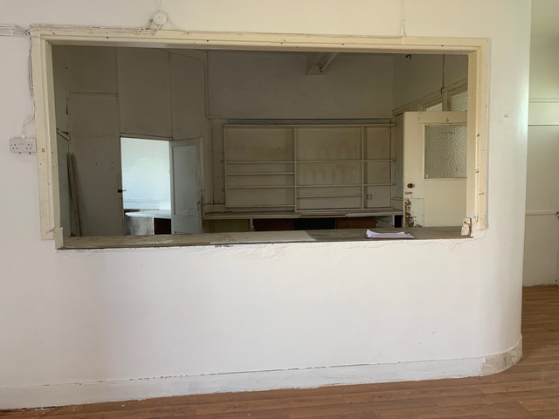
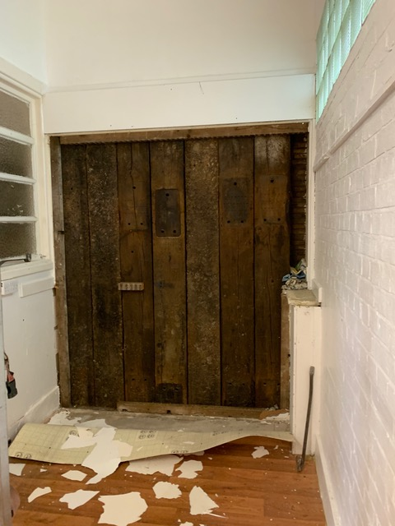
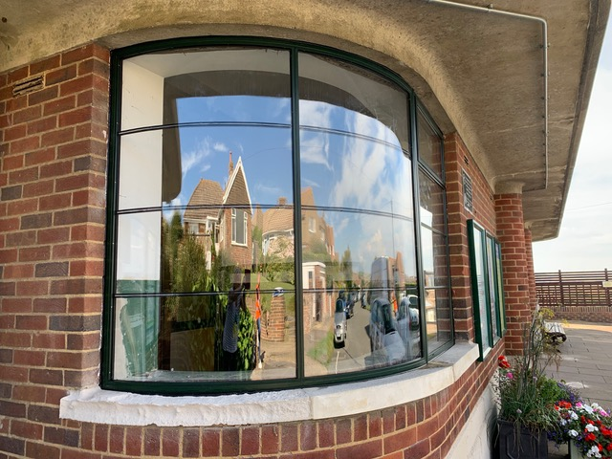
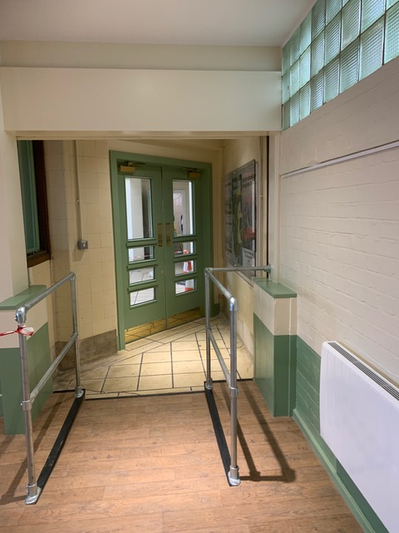
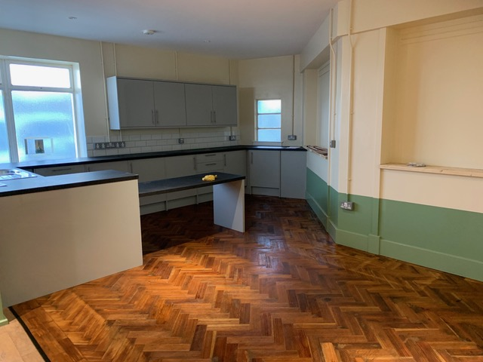
THE OLD PARCEL ROOM AT BISHOPSTONE STATION

Slide 5
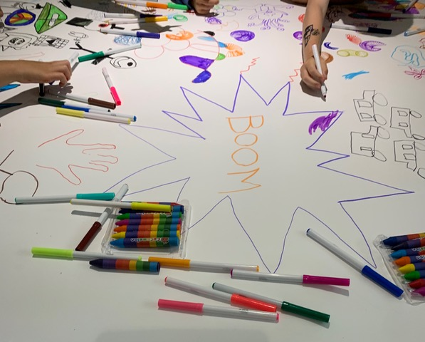
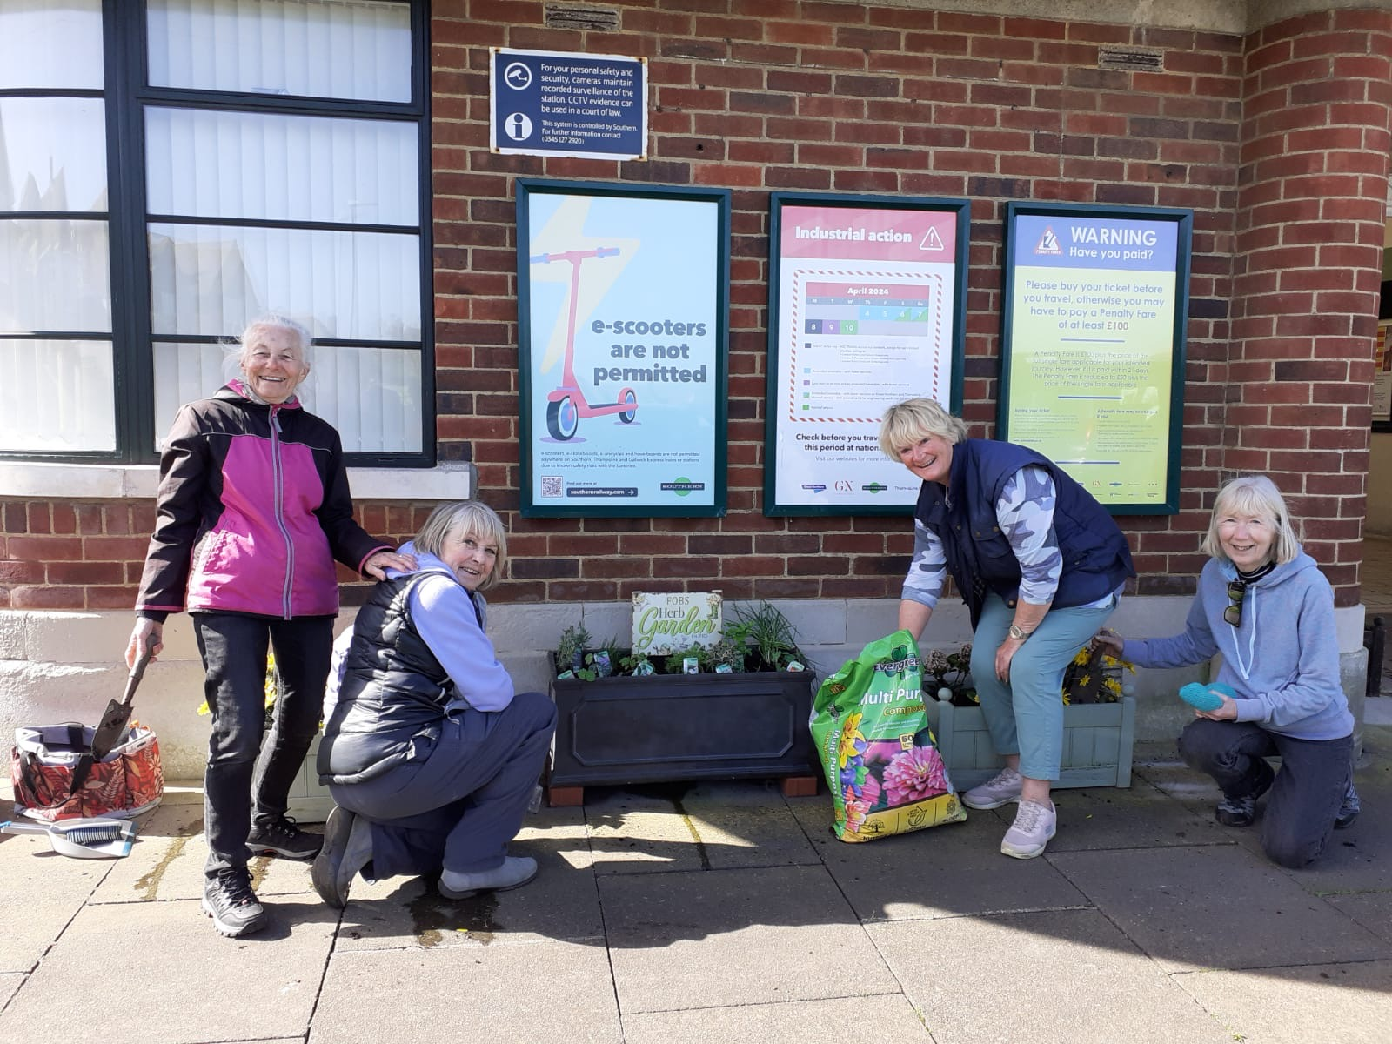
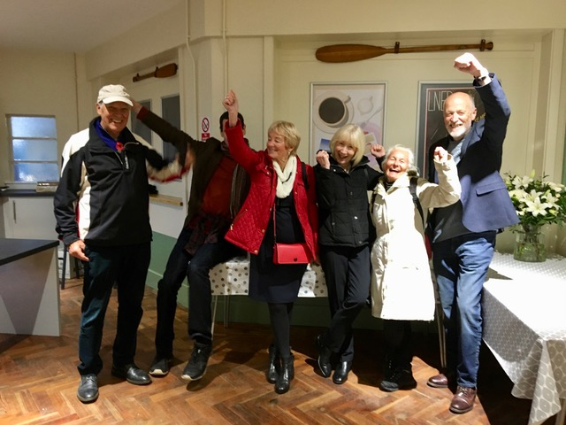
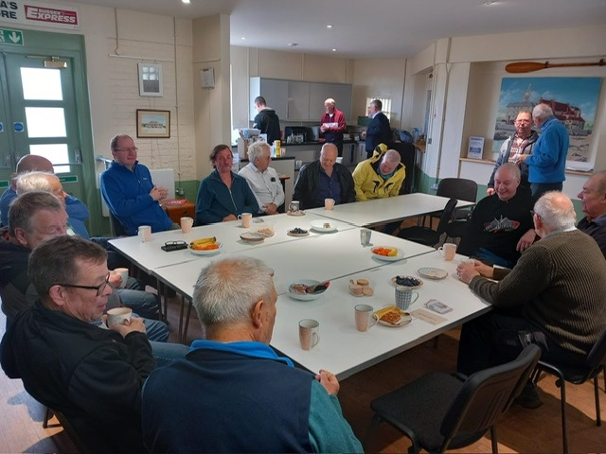
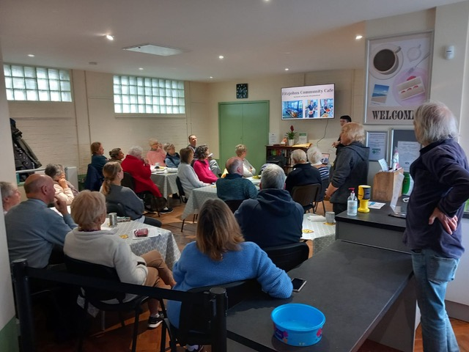
PROGRESS SINCE OPENING NOVEMBER 22.

Slide 6
RECOGNITION 23-24

