Slide 1
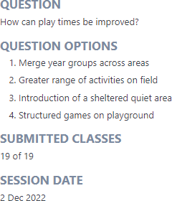
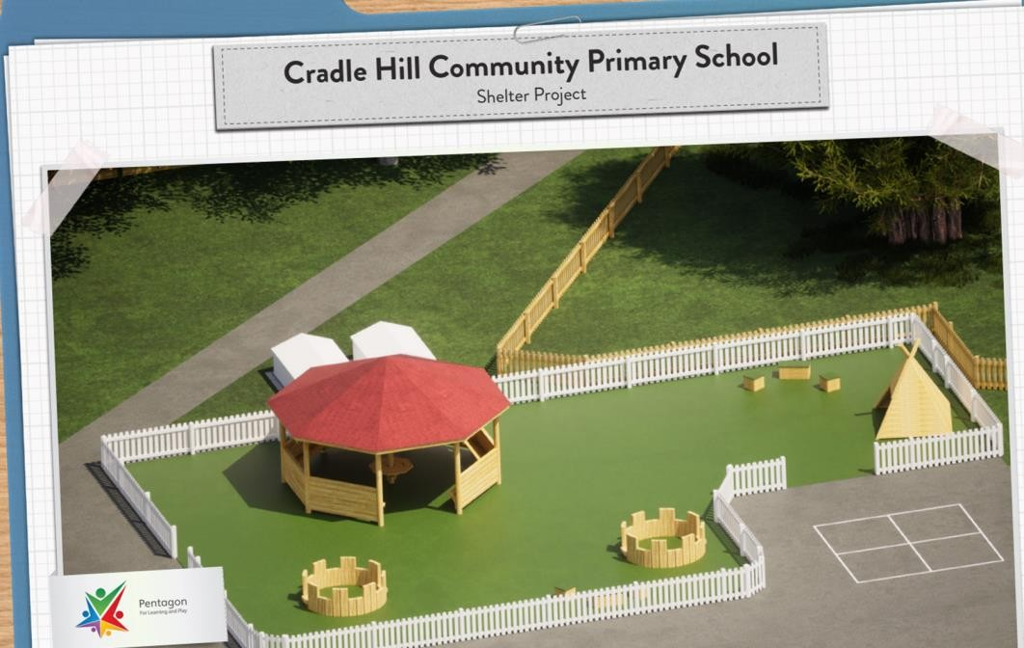
Our School Parliament Class Meeting December 2022 asked this question.
Over a year later…

Slide 2
How would a space like this change your playtimes and learning?
Quotes from some of our children:
"If someone is sad, it'll be a better place to sit and talk." "We could play chess!"
"If we're tired and need a break from running around and just want
to spend time with our friends, it would be a great place to go." "It'll be good if you want to find new people to play with."
"It'll give us a calmer playtime, so we'll be more relaxed and ready to learn."
"Learning in an outside classroom will be exciting!"
"For anyone suffering with their asthma, it'll be a more sheltered, calmer place to be."

Slide 3
If you have an idea, no matter how aspirational it may be, you can achieve it!

Slide 4
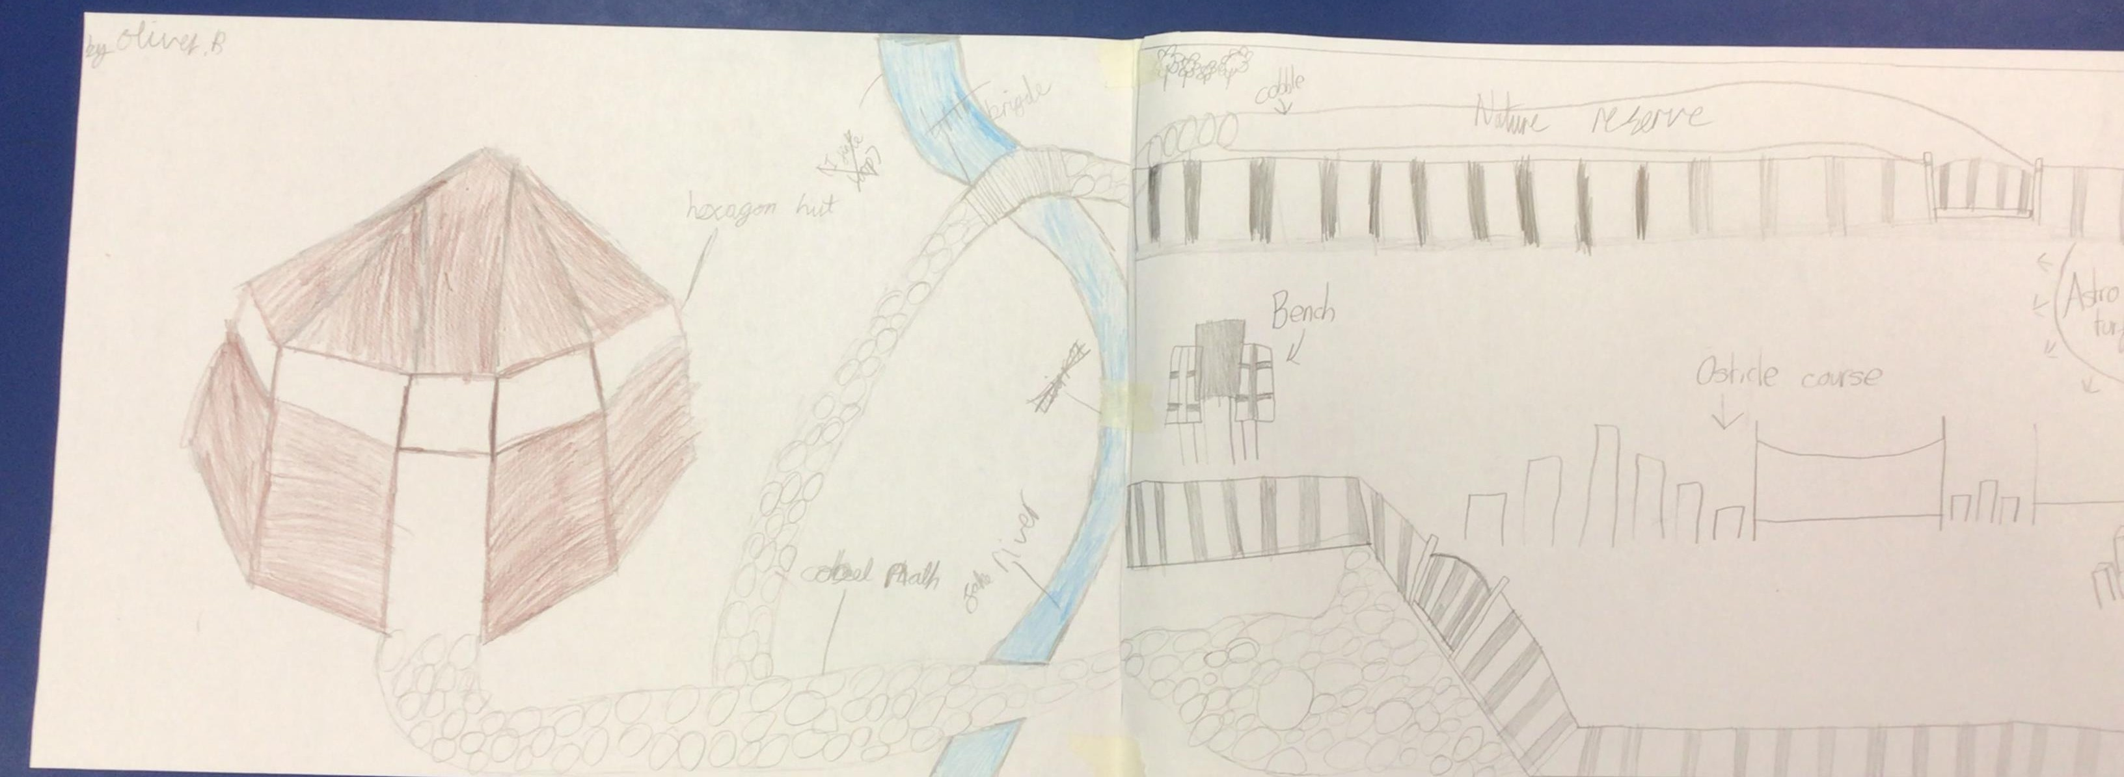
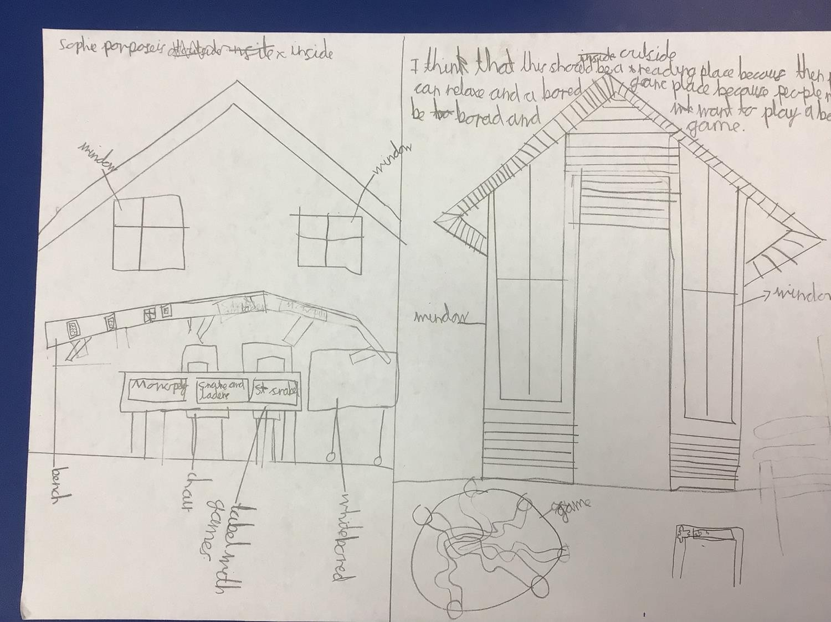
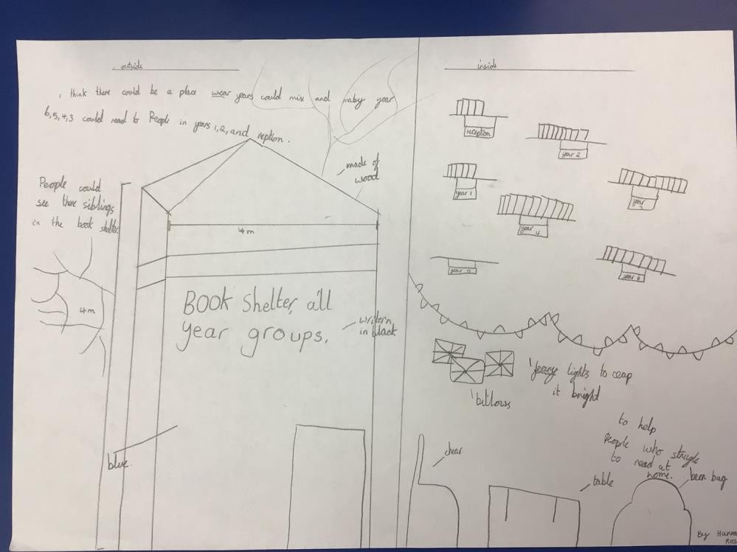
Many children came to a lunchtime design club.

Slide 5
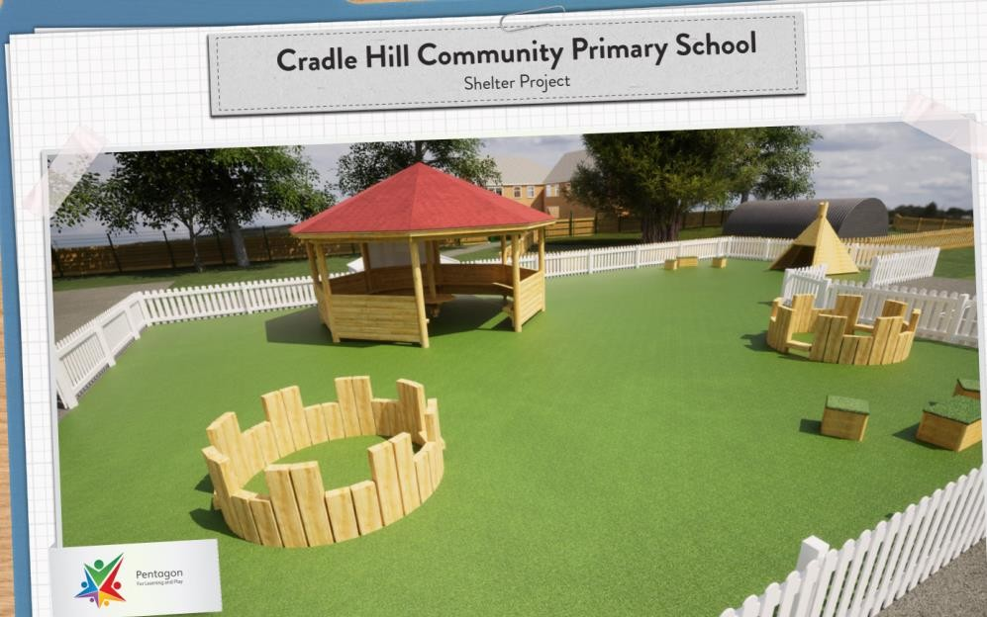
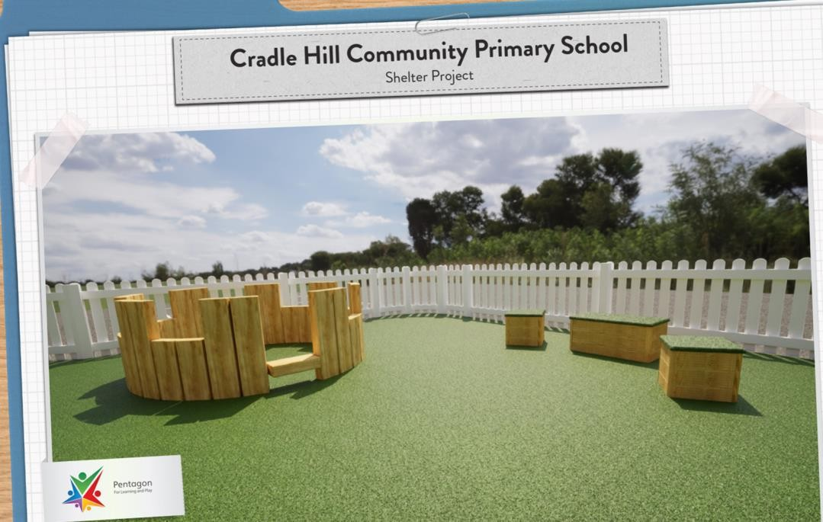
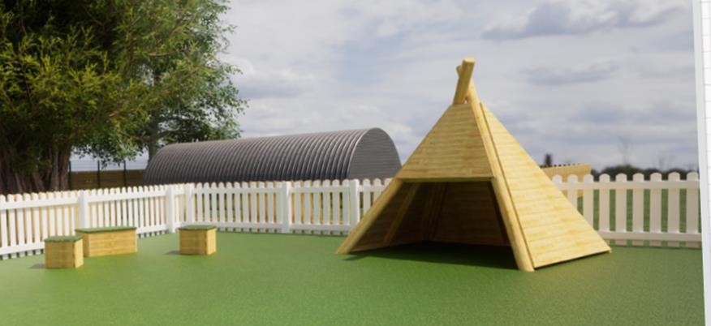
School Parliament looked at three different designs
from Pentagon Play and this is what they went for.
At this stage, the PTFA were heavily involved planning fundraising and writing to companies to support funding.
THANK YOU to everyone that made this aspirational idea become a reality.

Slide 6
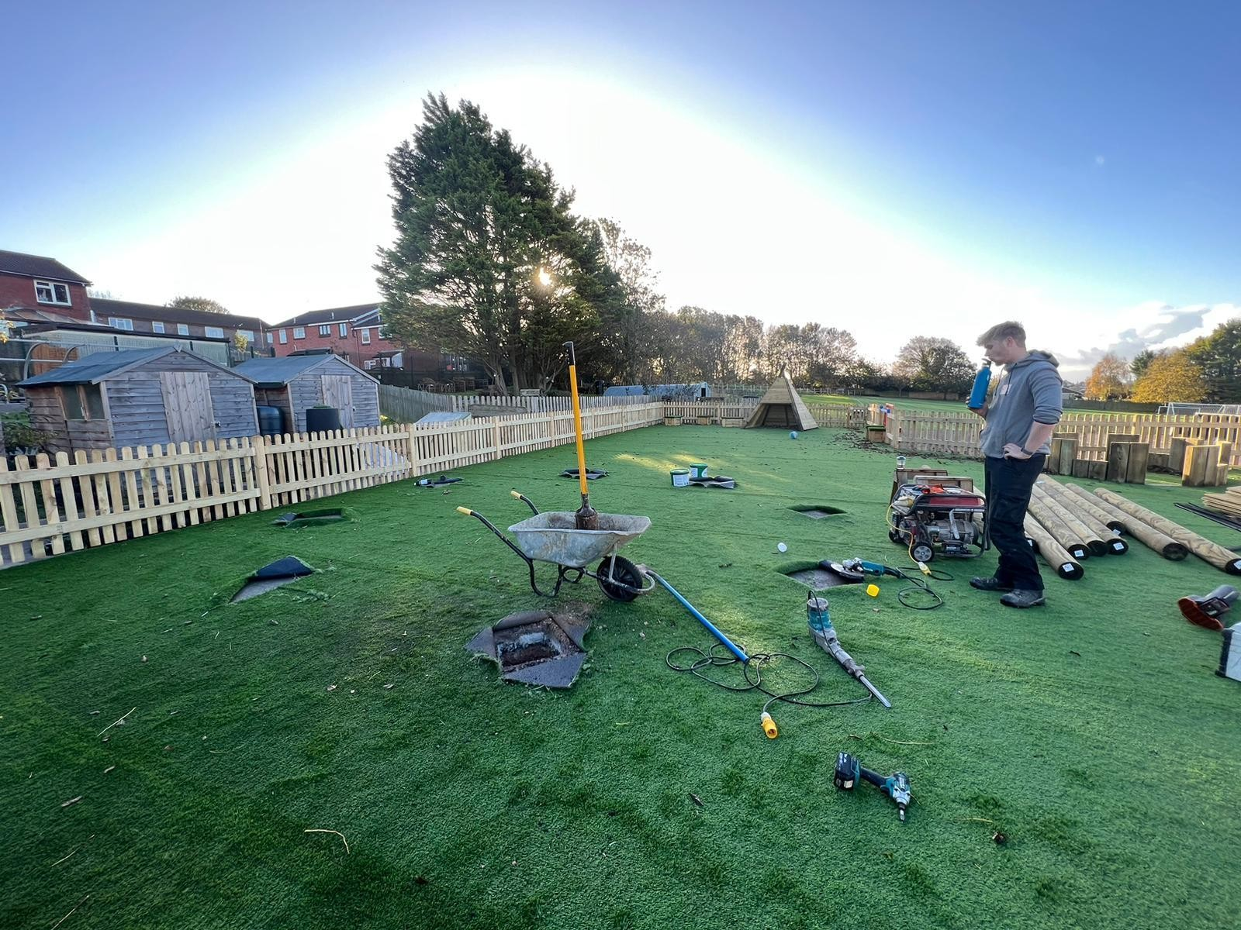
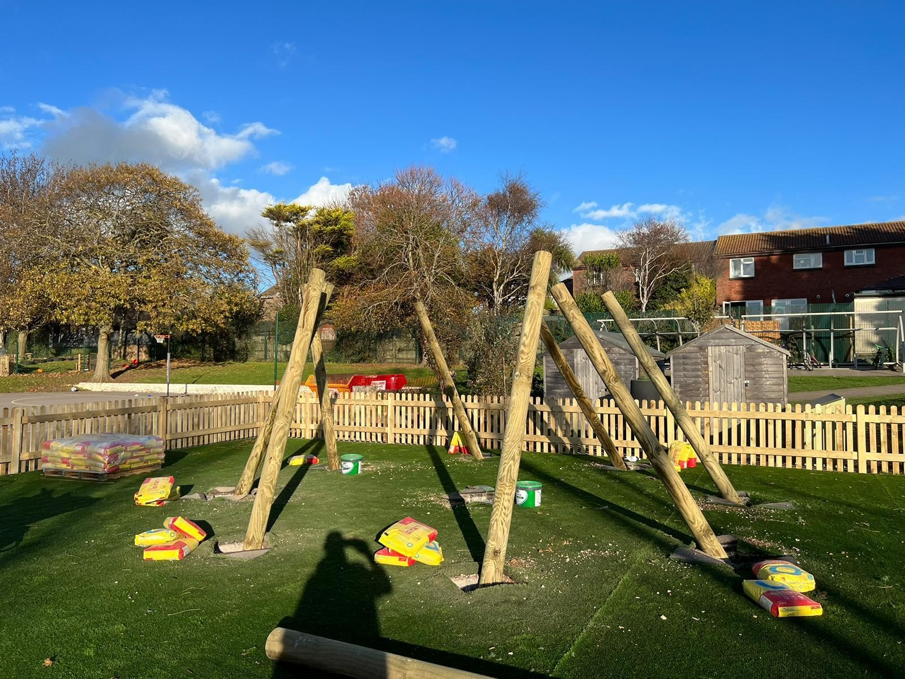
The fencing, talking circles and wigwam went in first but we had to wait for the gazebo.

Slide 7
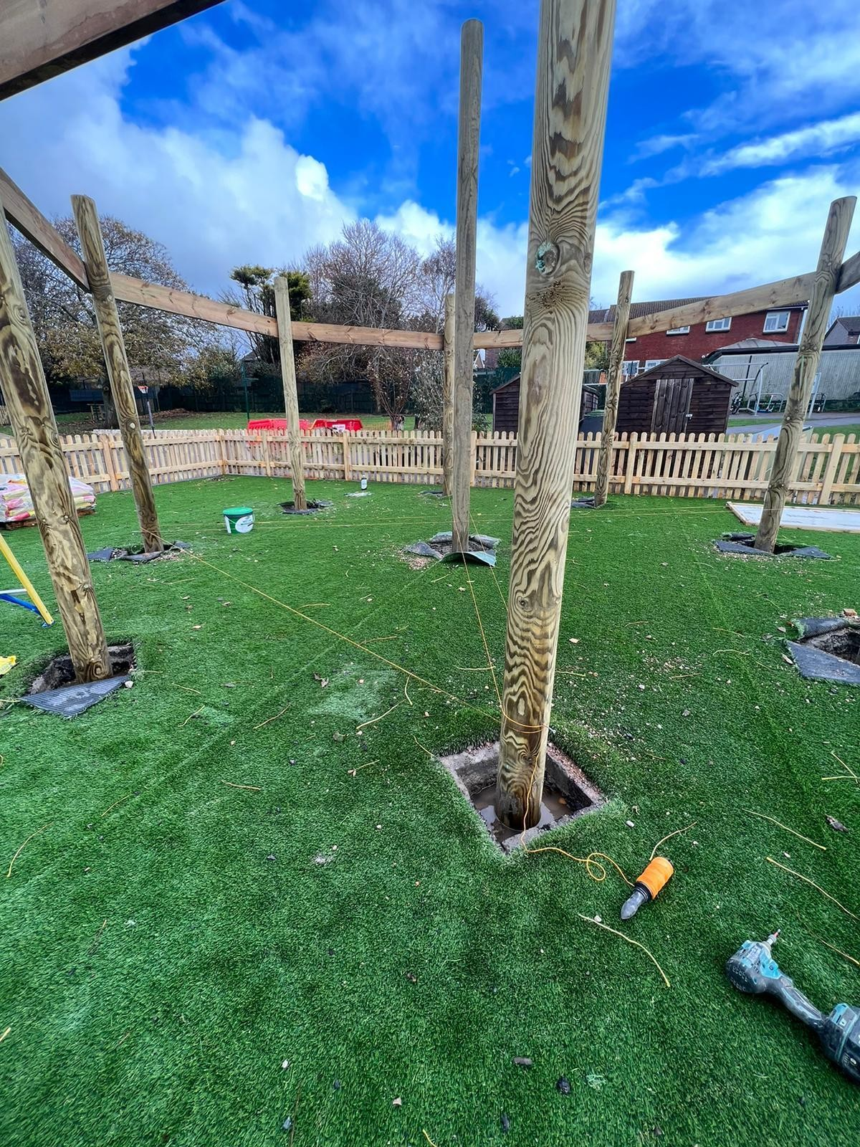
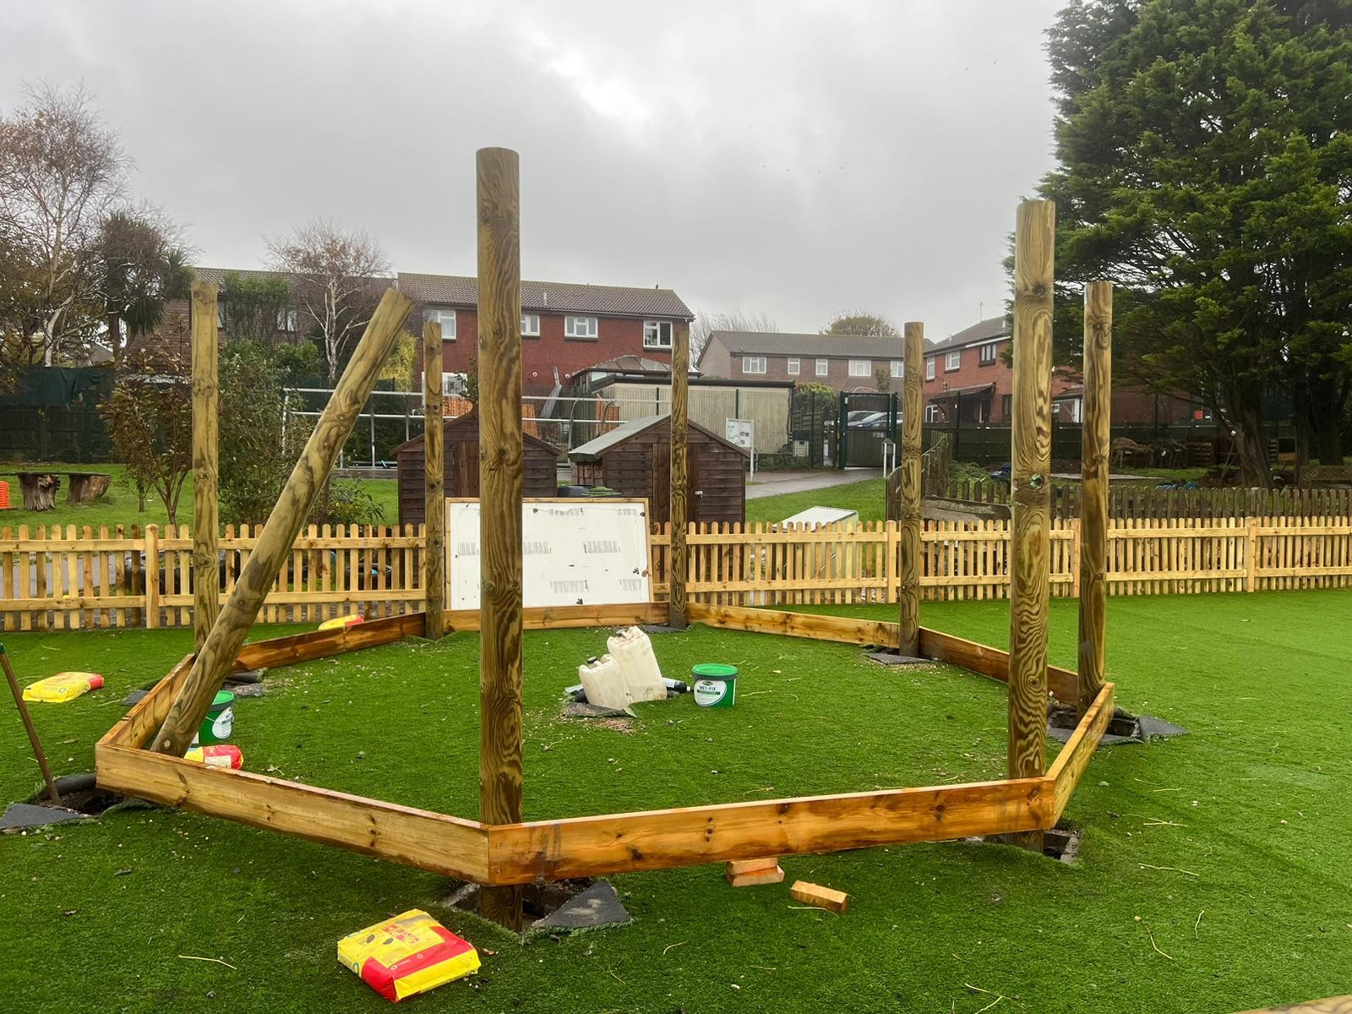
Construction of the gazebo began to happen the week before half term so children could see the progress day by day.
Pentagon Play came to give an assembly to KS1 and KS2.

Slide 8
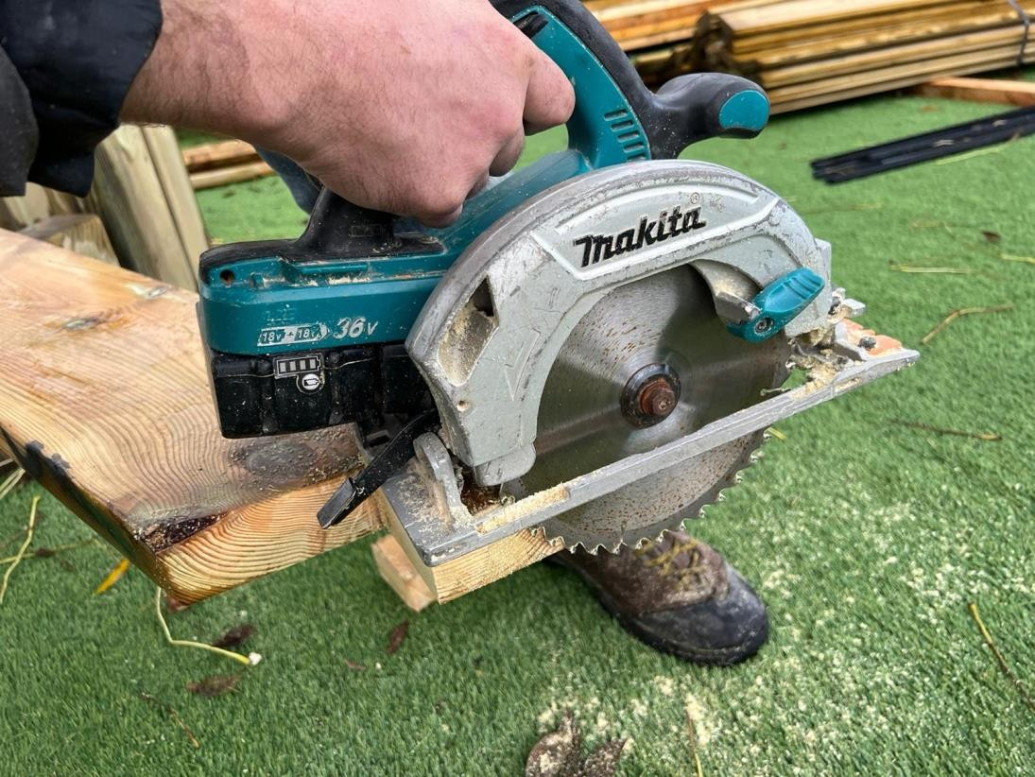
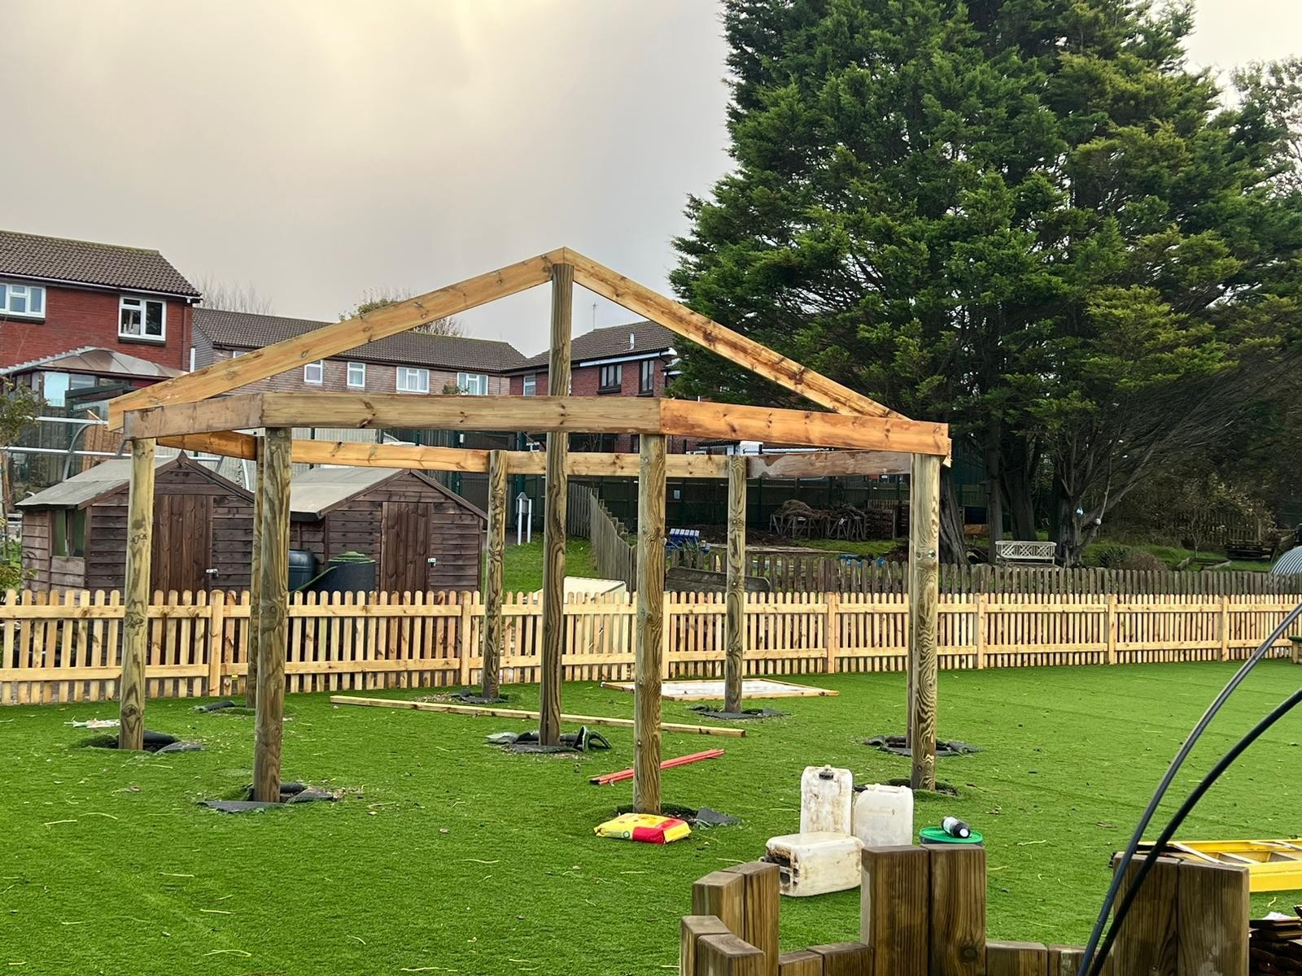
The build linked in nicely to Year 1’s DT unit on Freestanding structures so they will use this as a real example when the children design, make and evaluate their own structures.

Slide 9
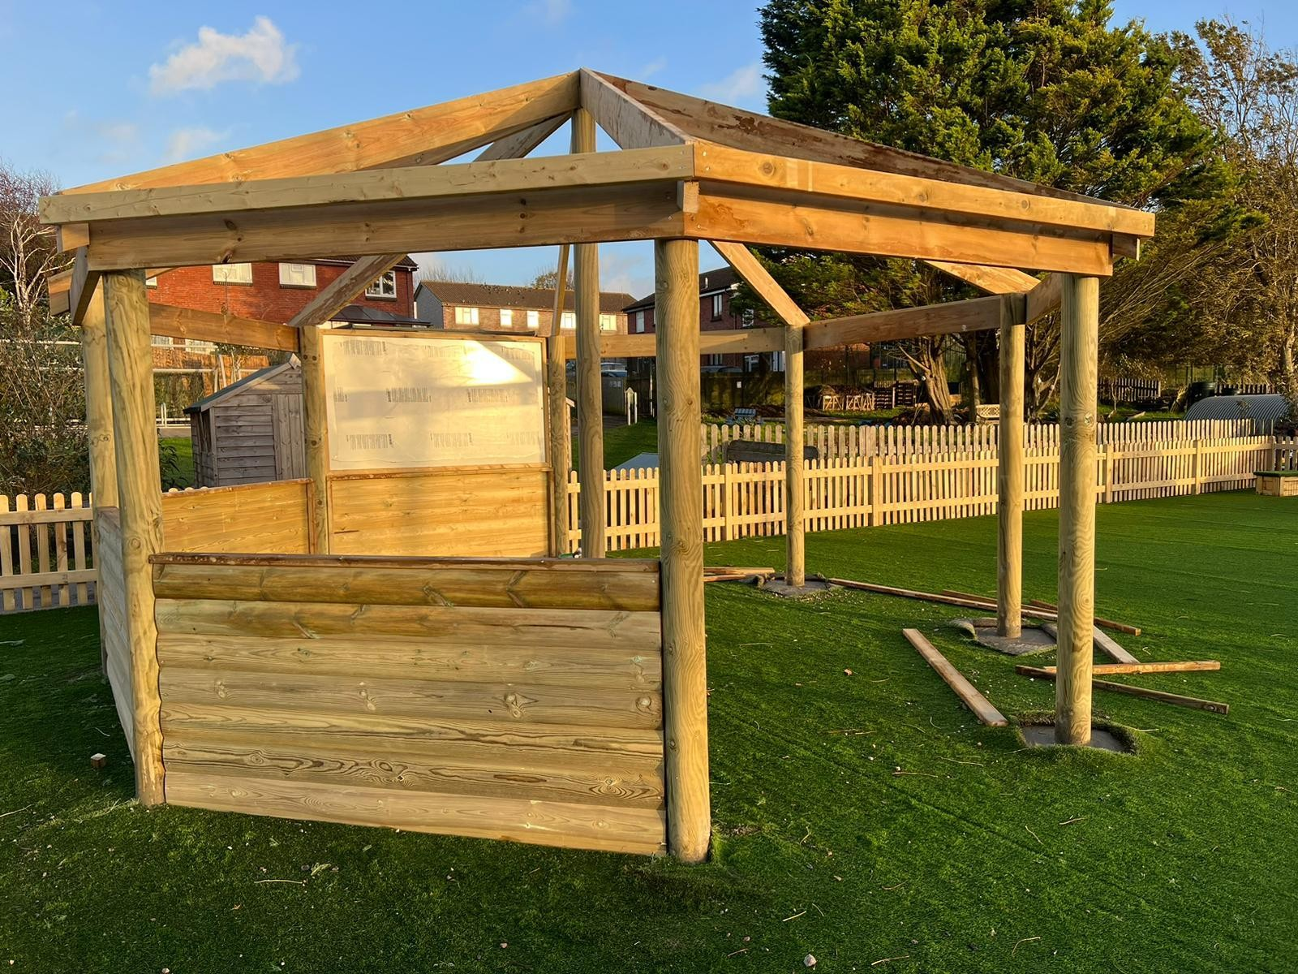
It’s big enough for 50 children to sit so will be fantastic as an outdoor classroom for the whole school in the better weather!

Slide 10
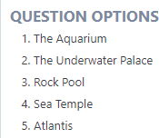
Then it was finished so School Parliament set another question.
What would you like to name our Quiet Area?
A couple of reasons for the choice:
Atlantis because the big hut is the town square and the little tents are like camping.
Atlantis - a little place that's free for anyone to use

Slide 11
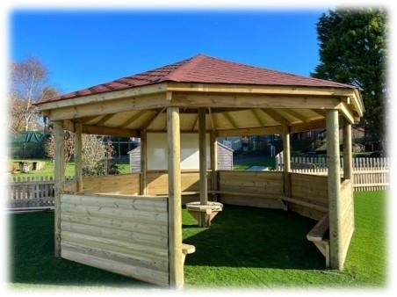
Teams
Monday
Atlantis
12.00 - 12.25 Art
12.30 – 1.10 Comic 12.00 – 12.25 DT Playground
12.15 – 12.45 Netball
12.30 – 12.55 Singing
Wednesday
Atlantis
12.00 – 12.25 Yoga
12.30 – 1.10 Rubik Cube
Friday
Atlantis
12.00 – 12.25 Chess
12.15 – 12.40 Times Tables
Playground
12.00 – 12.25 Yo Yo
12.30 – 1.10 Mixed Sports
Field
12.15 – 12.40 Football Skills
Thursday
Atlantis
12.00 – 12.25 Glittery Unicorn
12.00 – 12.25 Writing
12.15 – 12.40 Sensory Club
Field
12.00 – 12.25 Boys Football
12.00 – 12.25 Running
Tuesday
Atlantis
12.30 – 1.10 Talk-About-It
12.30 – 1.10 Art
Field
12.00 – 12.25 Girls Football

