Slide 1
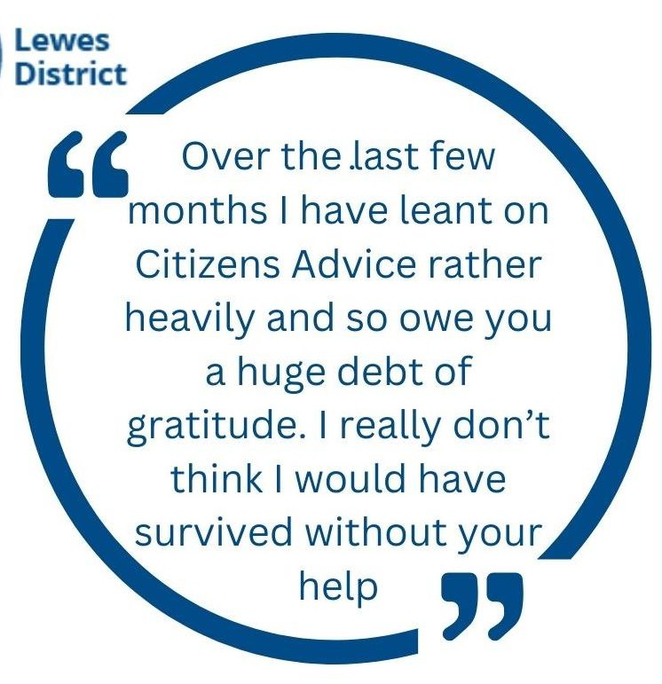
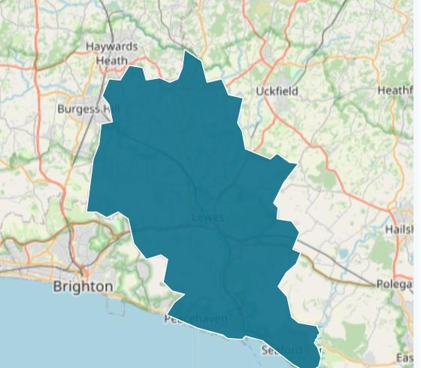
Our work across Lewes District and Seaford

Slide 2
We are here for everyone, whoever you are, whatever the problem
We are an independent registered charity. We provide free, confidential, professional and impartial advice on a huge range of issues and topics to help people overcome their problems.
We rely on local grants and fundraising to enable us to deliver our services across the district. We do not receive funds from or are part of central government. We are a member of the national Citizens Advice charity- but have our own, local, independent status.

Slide 3
Our work
Confidential, impartial, independent, free advice, education and support
Advice Quality Standard accredited and regulated by the Financial Conduct Authority
Empower people to find their way forward – whoever they are, whatever their problem
Volunteer contribution to the delivery of services
Research and campaigns to tackle the source of client problems
Issues
Huge range of issues
More complex issues
People coming to us with multiple areas of need.
More clients than ever before are in full-time employment
Food & fuel vouchers
Benefits check to maximise income – Help to Claim Universal Credit, applications and challenges for Disability benefits
Budgeting to help reduce outgoings
Help accessing charitable grants
Digital inclusion
Reducing utility bills
Managing debt
Housing issues: tenancies, disrepair
Employment: unfair dismissal, redundancies
Relationships: separation, access
Boundary issues, wills & probate,
education…

Slide 4
What we deliver in Seaford and for Seaford residents
Mondays from our Seaford office (pre-booked appointments, in-depth call backs). On average 8 people also drop seeking support.
Since June we have delivered community outreach drop in service in Bishopstone once a month and from Seaford Library on a monthly basis since Sep. Funding for these has ended and this support is due to end as unsustainable.
Wider offer across the district- Advice Line Tues-Thurs 10-3pm. Pre-booked appointments and call- backs in NH and Lewes. Welfare benefits and generalist caseworkers, Universal Credit specialist
Increasing organisational running costs and increasing demand for support are key challenges for LDCA. Seaford delivery costs £20,000/year (£6500 per year from Seaford town council on application) Therefore have an unsustainable shortfall of £13,500/year to run the service 1 day a week in Seaford.
High demand but not enough capacity- more funding and volunteer advisors are both critical

Slide 5
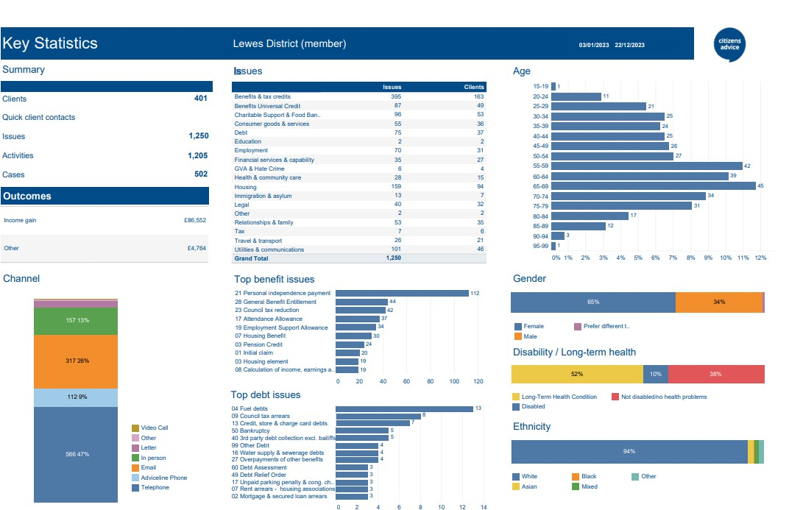
Seaford summary figures for 2023- who we help and with what
401 clients
1,250 issues
£90,000+ income gain
Top issues: Benefits,
Housing, Utilities
62% are disabled or have a long term health condition

Slide 6
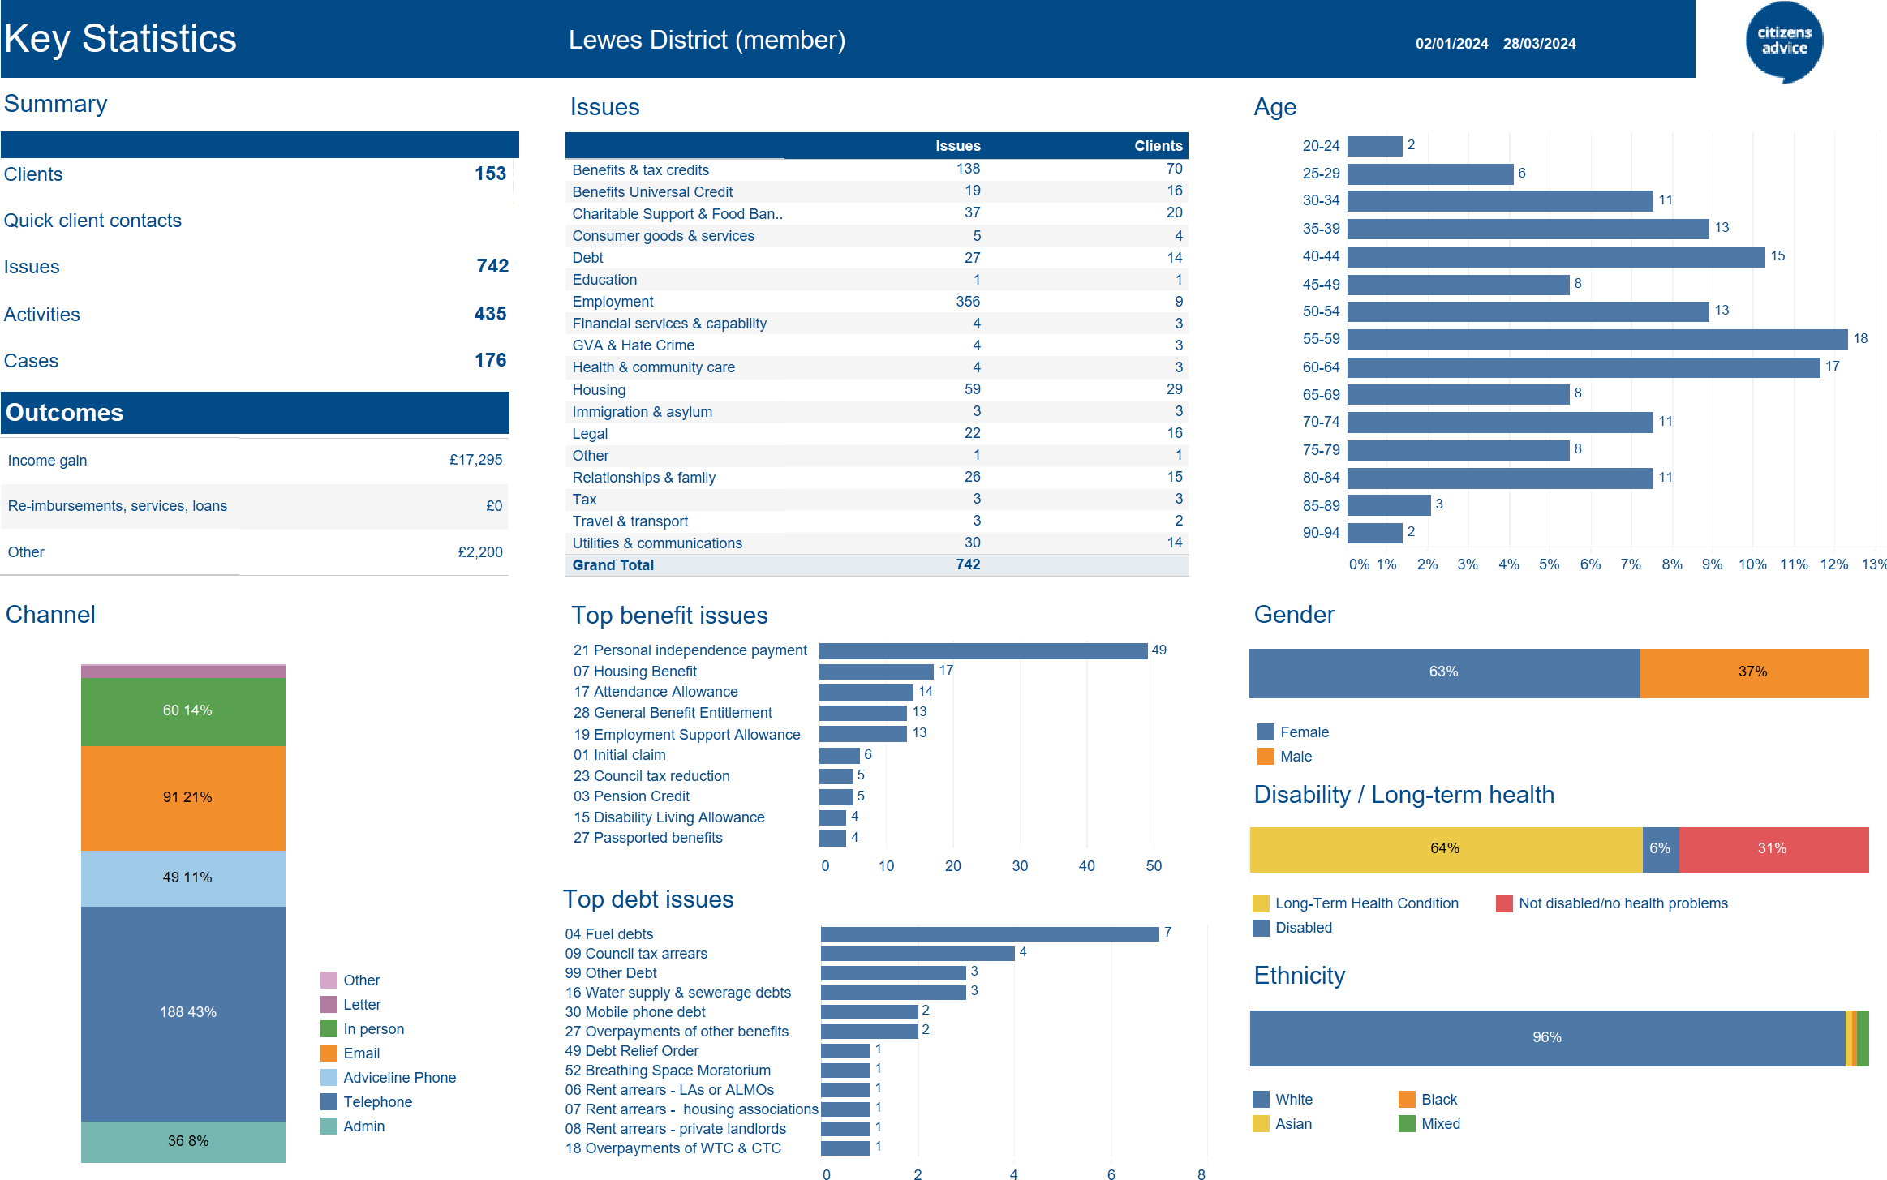
Seaford figures for the first quarter 2024
153 clients
742 issues
£19,495 income gain
Top issues: Benefits,
Housing, Employment
70% are disabled or have a long term health
condition

Slide 7
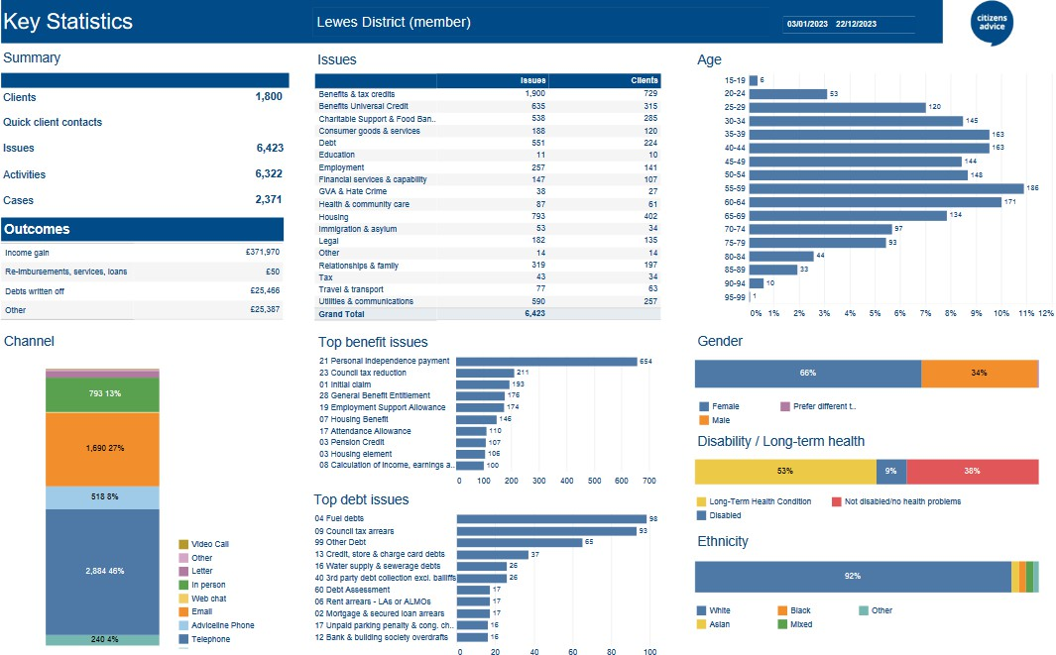
Lewes District summary figures
1,800 clients
6,423 issues
£420,000+ income gain
Top issues: Benefits,
Housing, Utilities
62% are disabled or have a long term health condition

Slide 8
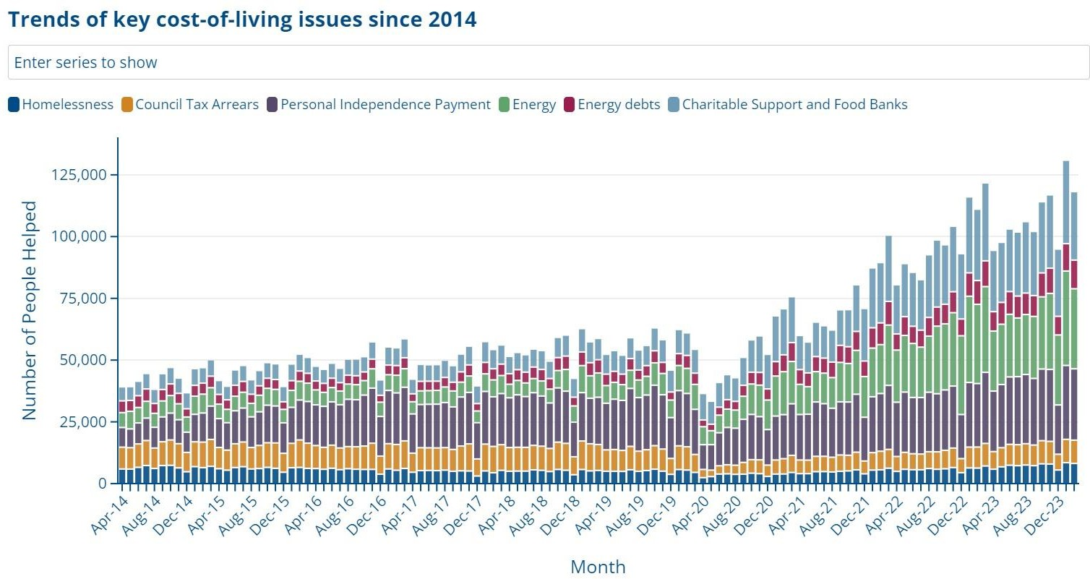
National trends- top 5 CoL issues

Slide 9
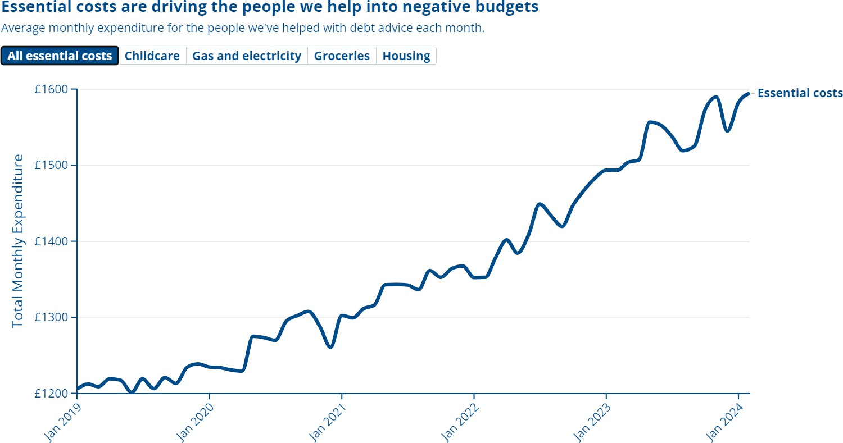
Negative budgets
Average monthly expenditure for the people we've helped with debt advice each month.

Slide 10
Housing and LHA rates
 | 1 bed | Shared Facilities | 1 bed | Self Contained | 2 Bed |  | 3 Bed |  | 4 Bed
Lewes / Newhaven LHA 2023 - 2024 | £428.83 |  | £797.81 |  | £997.27 |  | £1,196.69 |  | 1,690.35
Lewes / Newhaven LHA 2024 - 2025 | £585.00 |  | £917.50 |  | £1,196.69 |  | £1,446.03 |  | £1,994.50
Uplift | £156.17 |  | £119.69 |  | £199.42 |  | £249.34 |  | £304.15
 | 1 bed | Shared Facilities | 1 bed | Self Contained | 2 Bed |  | 3 Bed |  | 4 Bed
Seaford LHA 2023 - 2024 | £324.18 |  | £598.35 |  | £762.88 |  | £897.52 |  | 1,196.69
Seaford LHA 2024 - 2025 | £421.33 |  | £718.03 |  | £897.52 |  | £1,080.04 |  | £1,396.16
Uplift | £97.15 |  | £119.68 |  | £134.64 |  | £182.52 |  | £199.47
 | Feb 22nd 2024 LOWEST AVAILABLE Rental |  |  | £895 |  | £1,050 |  | £1,650 |  | £1,850
 | SEAFORD SHORTFALL |  |  | -£297 |  | -£287 |  | -£752 |  | -£653
 |  | Average | Median | Average | Median | Average | Median | Average | Median | Average | Median
 |  |  |  | £948 | £948 | £1,229 | £1,250 | £1,700 | £1,700 | £1,850 | £1,850
 | Total Available |  |  | 2 |  | 5 |  | 2 |  | 1
 | March 21st 2024 LOWEST AVAILABLE |  |  | £725 |  | £920 |  | £1,650 |  | £1,400
 | SEAFORD SHORTFALL |  |  | -£127 |  | -£157 |  | -£752 |  | -£203
 |  | Average | Median | Average | Median | Average | Median | Average | Median | Average | Median
 |  |  |  | £816 | £750 | £985 | £985 | £1,675 | £1,675 | £1,500 | £1,500
 | Total Available |  |  | 3 |  | 2 |  | 2 |  | 2
 | 2024 - 2025 LHA | £421.33 |  | £718.03 |  | £897.52 |  | £1,080.00 |  | £1,396.16
 | SEAFORD SHORTFALL on 2024 - 2025 LHA |  |  | -£7 |  | -£22 |  | -£570 |  | -£4

Slide 11
We must address core drivers of hardship- the consequences and impacts of poor policy
4 key areas of SS policy change are needed
-Design and delivery mechanisms of the social security system needs to be overhauled.
-Increase in awareness of entitlements
-Support to apply for and maintain benefits
-Uplift in basic income levels required to reflect real costs
-The eradication of benefit deductions, sanctions and caps to ensure people have the levels of income they are entitled to
£19 billion of unclaimed benefits nationally- needs to be a huge awareness drive to ensure people have the benefits and income they are entitled too
20% of people using food banks are working
Need to tackle issues before they reach crisis point- Trussell Trust and CitA- working towards preventative work to eradicate the need for food banks and charitable support
Need to ensure good access of services for working people - out of office hours access. We need more volunteers & funding to support us to be able to do this.
Drive to ensure people are not stuck in ever widening negative budgets (social tariffs, targeted support)
LHA cap- must be reviewed again and must track markets. Homelessness crisis looms
More social housing
Need to stop making further deductions from benefits that are already not meeting peoples essential needs

Slide 12
Key areas of concern to come and our work in Seaford
CoL crisis will continue and deepen- its an ongoing trend
Housing and homelessness crisis
Debt crisis- negative budgets increasing
Increasing poor mental health
Continued trend of people with long term health conditions and
disabilities being amongst those worst impacted
Maintaining our current work- LDCA total deficit for 24-25 across the organisation is £80,000. Must maintain current income levels and increase income by at least 80k, or services will be reduced and cut. Already using reserves.
Expanding our support in Seaford- Clear local need for more support and we have an ambition to
open our Seaford office on Tuesdays 12-6pm (12-2 drop in) (3-5.30 Advice Line)
Would like to reinstate our outreach drop in Bishopstone and at the library

Slide 13
LDCA will continue to be there for anyone across the district who needs our advice and support.
We are the only provider of a full range of holistic advice services, delivered by accredited advisors and case workers.
We urgently need to raise more funds and recruit more volunteers.
Thank you for your support

